Slide 1
Start Recording

Slide 2
Week 2
OOP – Under the covers!
The JVM
If statements
Loops
The Debugger

Slide 3
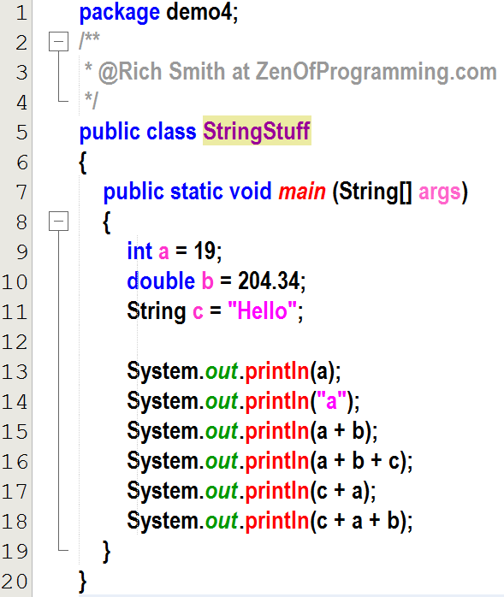
Quick Quiz!
Class Header
Class Name
Method Name
Method Header
Declaring a variable
of type int called ‘a’
and assigning it a
value of 19
int literal
String literal
Prints the letter ‘a’
Declaring a variable
of type String called ‘c’
and assigning it a
value of “Hello”
Prints 223.34
Prints 223.34Hello
Prints Hello19
Prints the contents of the variable a → 19
Prints Hello19204.34

Slide 4
Tell me the first three rules of the JVM

Slide 5

Rules of the JVM… So Far!!!
The first time a class is accessed, the JVM loads the bytecode from the .class file into the method area of memory.
The JVM always starts running our code at the beginning of the main method.
Variables whose type starts with a lower-case letter (int, double, boolean, etc) are PRIMITIVE variables. They store values that we can access later.

Slide 6
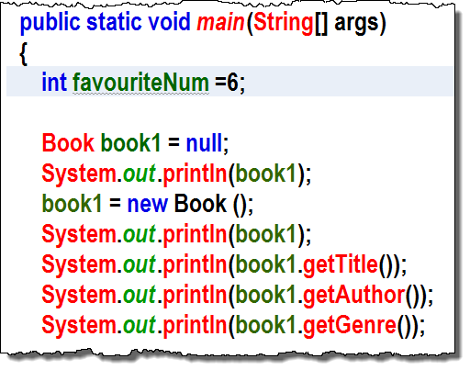
Local Variable
Any variable of any type that is declared inside of a method’s code block. (any method, not just the main method)
Local variables are always stored in the current stack frame of the stack, while the program is running
So, what’s a stack?
Stack
current stack frame: main
int favNum = 6
book1

Slide 7
The Stack
Stack
Heap
Method
The Stack
The Stack is an organized area in memory where stack frames are created and destroyed.
Every time a method is entered, a new current stack frame is created.
Every time a method is exited, the current stack frame is destroyed.
All local variables are stored in the current stack frame.
A local variable is any variable that is declared inside of a method.
Current Stack Frame:
– contains local variables
Stack Frame:
– contains local variables
Stack Frame:
– contains local variables
Stack Frame:
– contains local variables
Stack Frame:
– contains local variables

Slide 8
The Stack
Stack
Heap
Method
The Stack
The Stack is an organized area in memory where stack frames are created and destroyed.
Every time a method is entered, a new current stack frame is created.
Every time a method is exited, the current stack frame is destroyed.
All local variables are stored in the current stack frame.
A local variable is any variable that is declared inside of a method.
The Stack
The JVM can always see the local variables in the current stack frame.
Bottom Line:
Every time the JVM enters a method, a new current stack frame is created.
Every time the JVM exits a method, the current stack frame is destroyed
All variables declared inside of that method are local variables and are stored in the current stack frame.
Current Stack Frame:
– contains local variables
Stack Frame:
– contains local variables
Stack Frame:
– contains local variables
Stack Frame:
– contains local variables
Stack Frame:
– contains local variables

Slide 9
Rules of the JVM
The first time a class is accessed, the JVM loads the bytecode from the .class file into the method area of memory.
The JVM always starts running our code at the beginning of the main method.
Variables whose type starts with a lower-case letter (int, double, boolean, etc) are PRIMITIVE variables. They store values that we can access later.
The stack holds stack frames. The top stack frame is called the current stack frame
When the JVM enters a method, a new current stack frame is created
All local variables are placed in the current stack frame.
When the JVM exits a method, the current stack frame is destroyed, and all of the local variables are destroyed with it. (So, a local variable only exists while the method it was declared in is running!)

Slide 10
Remind me again…
How do we know that a variable is primitive?
Its type starts with lower-case (int, double, boolean etc.)
What do we store in a primitive?
Values (like 7, 8.2, true, etc)
How do we know that a variable is local?
It is declared inside of a method
Where is a local variable stored?
Inside the current stack frame
Is a String primitive? Why?
NO! The String type starts with a Capital (However, the people that wrote java try to make String act like a primitive as much as possible)

Slide 11
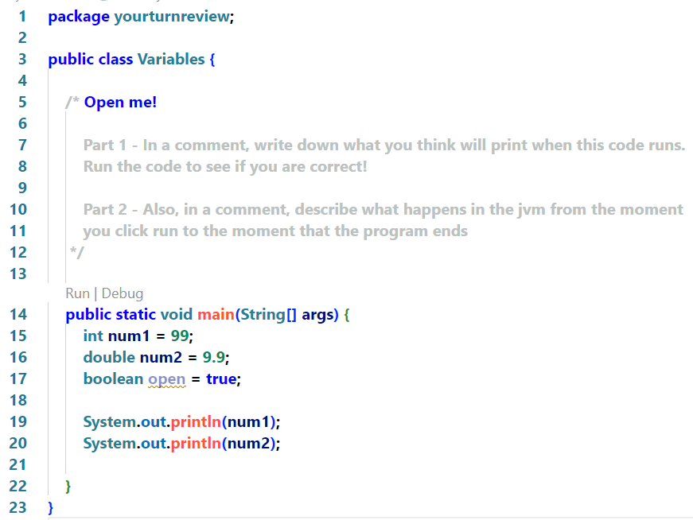
Week 2:
Your Turn!
Write down what happens in the JVM from the moment you click run to the moment that this program ends.
4 mins

Slide 12
Answer
The first thing that happens is that the VSCode calls the compiler to compile our source into bytecode which it saves to the disk as Variables.class.
Next, VSCode starts up the JVM and passes it the location of the Variables.class file.

Slide 13
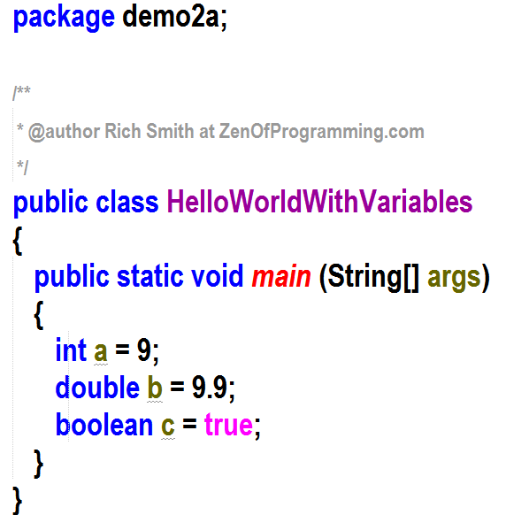

Stack
Heap
Method
When the program starts, the class loader loads the HelloWorld.class bytecode into the code section and the main method starts to run
0: iconst_2 1: istore_1 2: iload_1 3: sipush 1000 6:
New current stack frame created every time a method is entered
Local variables are stored in the current stack frame
main
Current stack frame (as well as all of the local variables stored in it) is destroyed when method ends
boolean c = true
double b = 9.9
int a = 9

Slide 14
Week02.yourturn1: Parts A,B,C and D (if you dare!)
Follow the instructions in the yourturn1 package
15 mins

Slide 15
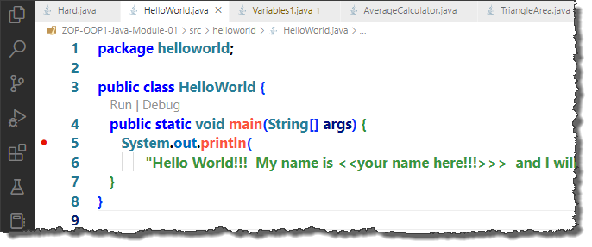
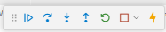
Remember the DEBUGGER?!
Think of the debugger as a combination Freeze-Ray and X-Ray Machine
Step into button
Debugger control panel
breakpoint
We will use the debugger a lot in this course. This is just a small glimpse of what it can do!

Slide 16
If you would like to permanently adjust the settings so that the JVM only steps through OUR code
The JVM will happily step through all of the code in every class in the Java API but that isn’t really very useful to us.
We want to step through our own code and ignore any code in the Java API that we may call.
Notes:
All of the Code Projects (Weeks) in this course have had the settings.json file in the .vscode folder changed to only step through our own code.
However, any new Java Projects that you may create (assignments for instance) will not have this setting set and will step through all of the Java API code as well.
If you follow the next slides, you can make a global setting for all Projects

Slide 17
To do this, we need to change a setting
By default, the Debugger will step into all code, including the classes in the Java API
We need to tell it not to step into those classes by opening our user settings file and making a small change.
We will walk through it together but PLEASE let me know if you have any problems! I can help and it’s important for us to have a working Debugger!

Slide 18
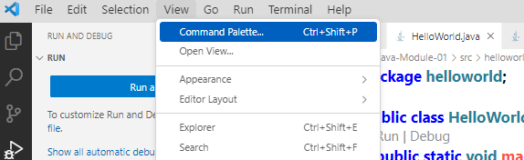
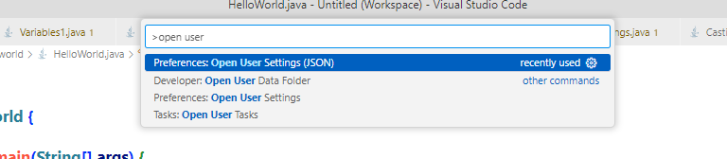
To do this, we need to change a setting
Click on View -> Command Pallette
Start typing: open user… until you see the “Preferences: Open User Setting (JSON)” Click on that!

Slide 19
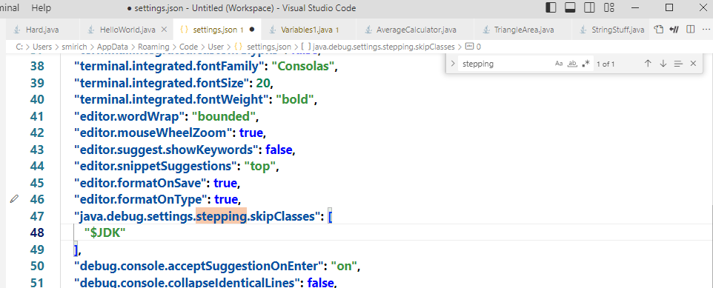
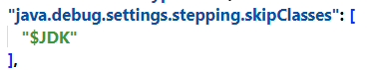
1. Type CTRL F (Command F) to open the find searchbox
2. Type stepping into the search box
3. You will find this line. Add the “$JDK between the brackets.
If you can’t find this line, add in the entire section manually on line 2 of the file
If you have problems, LET ME KNOW!!!! I CAN HELP!!!!

Slide 20
Let’s Debug our program
Week02.yourturn1complete.AboutMe

Slide 21
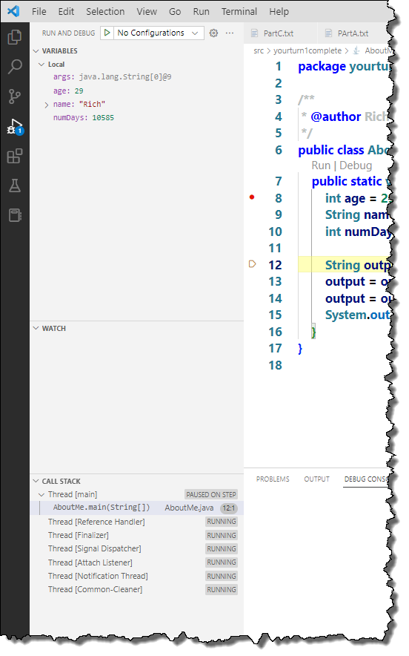
Using the Debugger
About the debugger:
The debugger allows us to pause our program on any line and look at the variables. Think of it as a freeze ray combined with an X-Ray machine.
Before we can use the debugger, we must add a break-point
To add a breakpoint, open AboutMe in the yourturn1complete package, move your cursor to the left of the 8 in line 8 until you see a faint pink dot. Click on the mouse and the faint pink dot will become a solid pink dot. You have now added a breakpoint at line 8.
After adding a breakpoint, VSCode will freeze our program when it gets to the beginning of line 8!
Notice the new window called Call Stack.
This window shows you all of the stack frames. Notice that the current stack frame is main!
Finally, notice the window called Variables. This window shows us all of the local variables in the current stack frame

Slide 22

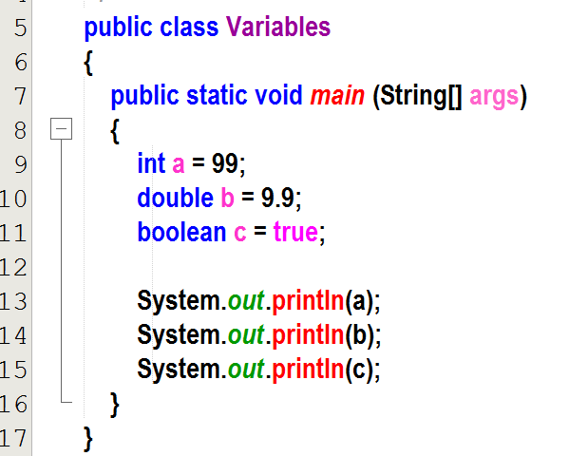
Your Turn!
Work through all of the programs in yourturn 1 with the debugger. Try to guess what’s going to happen in the Variables window before each time you click on the step into button
10 mins

Slide 23
Review
When a program starts, the Class Loader loads the .class file into the method section of memory.
The JVM will always start running the code in the main method first.
Every time a method is entered, a new current stack frame is created in the Stack area of memory
This current stack frame contains all of the variables that have been declared inside of the method. We call these local variables.

Slide 24
Review
Every time the JVM exits a method, the current stack frame is destroyed and all of the local variables that were stored in it are destroyed along with it.
This is why variables declared inside of a method only have ‘scope’ or only exist inside of that same method. We’ll talk more about scope soon.

Slide 25
Review
In Java, Classes always start with a CAPITAL.
MyClass
DataAccessObject
methods always start with a lower-case *
myVariable
numApples
* There is one exception...Constructor methods start with a CAPITAL
We'll learn about Constructors soon!

Slide 26
Who am I?
Every java program has at least one of me…
Class
public class MyClass
A main method
public static void main (String [] args)
We contain everything inside a class and we can contain everything inside a method…we are the beginning and ending of a code-block
{ }
I am the syntax for declaring a variable…
int myVariable = 12;
double myFractionalVariable = 12.2568;

Slide 27
Who am I?
I am the thing that programmers declare in their code in order to store things like numbers or true/false.
Primitive variables
I am the area in memory where local variables are stored.
Stack Frames (which are stored on the Stack)
In Java, no code exists outside of me. I am the thing that all programmers put their code inside.
Class

Slide 28
Who am I?
I am used to tell the compiler that it is ok to take a double type and truncate it in order to fit it inside an int type.
Casting
I am the symbol that exists at the end of every line of code that is not followed by a {
Semicolon ;
I store nuts in trees for the winter
squirrel
I am the name of the file that contains the bytecode after the sourcecode file called MyClass.java has been compiled.
MyClass.class

Slide 29
Who am I?
I am created whenever the JVM enters a new method.
New Current Stack Frame
I am declared inside of a method
Local Variable
I am where local variables are stored
Stack Frame
I am the area in memory where bytecode gets loaded
Method Area
I am destroyed whenever the JVM exits a method. (2 answers!)
Current Stack Frame
All of the local variables that are stored in the current stack frame

Slide 30
Who am I?
I am the library of code that has been written as part of java so that programmers can call that code instead of having to write everything themselves.
Java API
I understand bytecode and machine code and can translate between them on the fly.
JVM
I am getting tired of answering these Who am I questions right now.
Me!

Slide 31
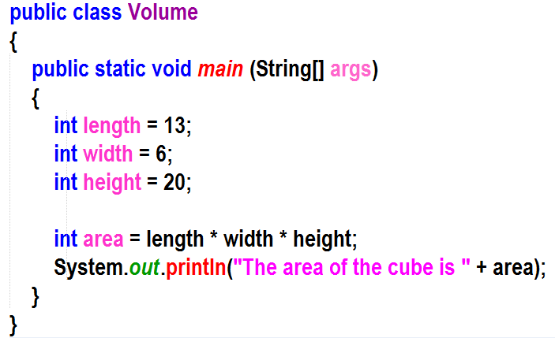
What is this?
Class Name

Slide 32
Class Header
What is this?

Slide 33
Declaring a variable of type int called length and assigning a value of 13;
What does this do?

Slide 34
Variable Type
What is this?

Slide 35
Variable Name
What is this?

Slide 36
Class Code Block
What is this?

Slide 37
Method Code Block
What is this?

Slide 38
Why is this variable Local?
Because it’s declared inside of a method
(in this case, the main method )

Slide 39
Where are local variables stored?
In the current stack frame on the stack

Slide 40
What happens when a method starts running?
A new current stack frame is built on the stack

Slide 41
What happens when a method ends?
The current stack frame is destroyed (kaboom!!), along with all of the local variables that were stored in it.

Slide 42
String literal
What is this?

Slide 43
Pop Quiz!
The compiler turns what into what?
What is a local variable?
This person is on the way to becoming a software architect!
Any variable declared inside of a method
source code into bytecode
What is concatenation?
Where are local variables stored?
Me!
Putting two strings together
In the current stack frame (which is stored in the stack)
The JVM interperets what into what?
The JRE contains?
bytecode into machine code
JVM and Java API

Slide 44
Decisions

Slide 45
So far our programs run straight through from top to bottom.
Java Statement
We call this sequence.
Sequence is one of the three building blocks of algorithms
The other two are:
Decision (sometimes called selection)
Iteration (looping)
Sequence just means that we follow the instructions in order, one line after another.
Our programs have been flowing from top to bottom in sequence.
This is about to change!!!
Java Statement
Java Statement
Java Statement
Java Statement

Slide 46
Introducing Decision (Selection)!
Java Statement
Java Statement
Java Statement
Yes
(true)
No
(false)
Java Statement
Is a > b?
Java Statement
Java Statement
Java Statement
Java Statement

Slide 47
A new primitive variable type: boolean
boolean myBooleanVar = true;
Boolean variables are either true or false
We can evaluate boolean expressions and store the true/false value in our boolean variable
So what’s a boolean expression?
A boolean expression is like a true/false question on a test.
What would you circle on a math test if I asked you
TRUE or FALSE (7>3)
TRUE or FALSE (7<3)

Slide 48
Boolean Expressions
Use the debugger!
Week02.booleans.BooleanExpressions

Slide 49
Boolean Expressions
Comparison Operators
< less than
> greater than
<= less than or equal to
>= greater than or equal to
== equal to
!= not equal to
! not

Slide 50
Logical Operators
What if I want to test for two things to be true?
For example, what if I want to know if a number is greater than 10 and less than 20?
&& means AND
|| means OR
! We already know this means NOT
^ means EXCLUSIVE OR
(Exclusive OR evaluates to true if one or the other of two conditions are true but not both.)

Slide 51
Who remembers Bedmas?
Left to right!
B | Brackets
E | Exponents
DM | Division or multiplication
AS | Addition or subtraction
Well, Welcome to BNAO
(pronounced BNNAAAAOOOO ;->)
Left to right!
B | Brackets
N | Not !
A | And &&
O | OR ||

Slide 52
BNAO
Week02.booleanorder.OrderOfOps

Slide 53
If Statements! Now Things get interesting....
If statements allow us branch the flow of our code, based on Boolean expressions!
Java Statement
Yes
(true)
No
(false)
Is a > b?
Java Statement
Java Statement

Slide 54
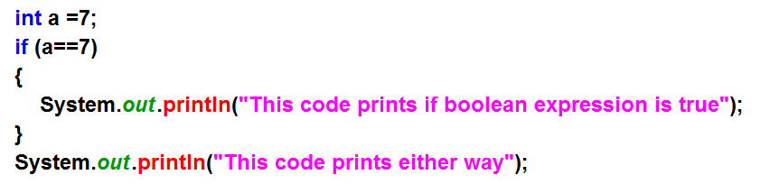
Anatomy of an if statement
The keyword if
If our Boolean expression evaluates to true, we run this code block
A boolean expression
This line is after our if code block so it will run either way

Slide 55
If Statement
T

Slide 56
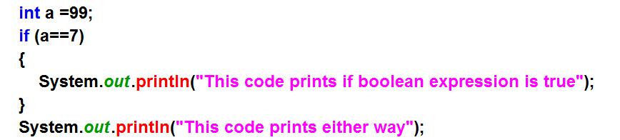
If Statement
F

Slide 57
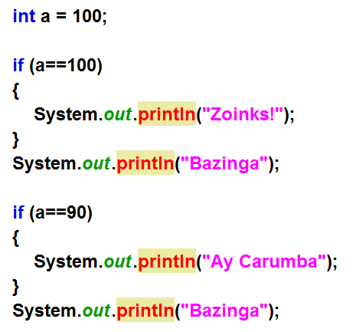
Ifs
T
F

Slide 58
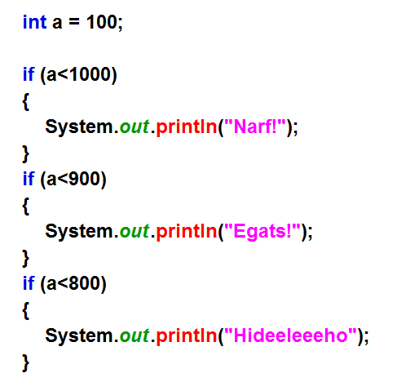
T
T
T

Slide 59
Week02.Yourturn2.Iffy (PartA)
6 mins

Slide 60
if/else Statements
OK, what if we want to do one thing if a boolean expression evaluates to true and another thing if it evaluates to false?
If you are hungry
Eat two slices of pizza
Else
Eat 1 slice of pizza

Slide 61
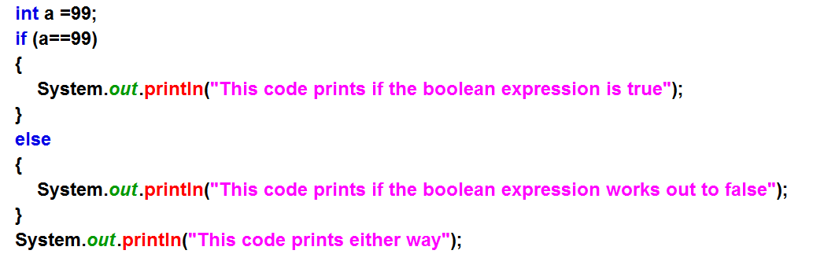
Anatomy of an If/Else Statement
The keyword if
Keyword else
If our Boolean expression evaluates to true, we run this code block
If our Boolean expression evaluates to false, we run this code block
One, and only one of these code blocks will run. One of the code blocks must run. The other one must not run

Slide 62
If / Else
T

Slide 63
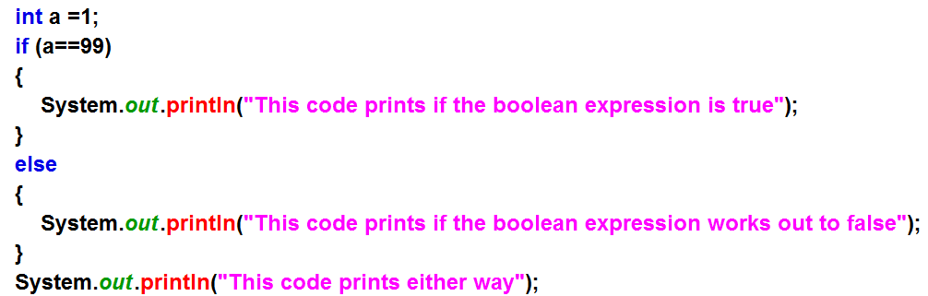
F

Slide 64
Week02.Yourturn2.Iffy (PartB)
5 mins

Slide 65
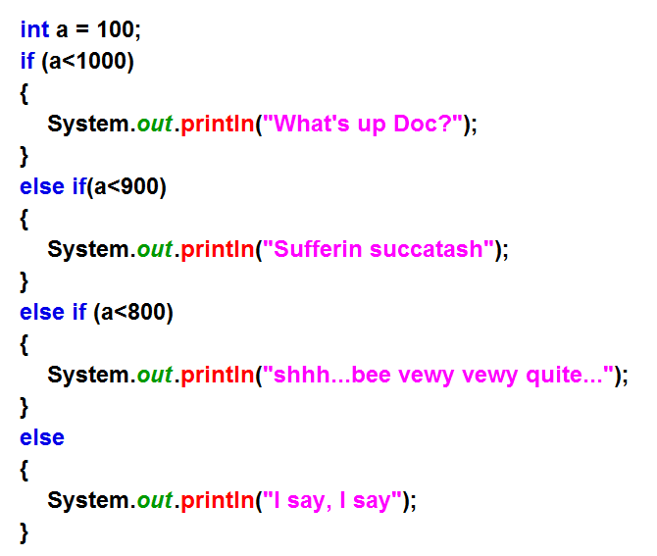
Anatomy of an If/Else Statement
The keyword if
Keyword else if
You can have as many else ifs as you like
Optional Keyword else
You don’t need an else but, if you include one, it will always run if NONE of the other Boolean expressions evaluate tot true
Only one of these code blocks will run. Once a condition is met, that code block runs and then the JVM moves to the end of the if/elseif/else statements

Slide 66
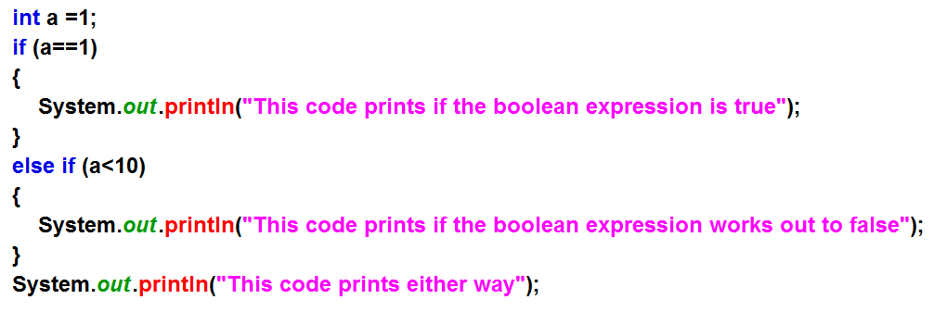
At most, only one code block will run
T

Slide 67
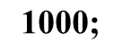
Sometimes, no code blocks will run
F
F

Slide 68
T

Slide 69
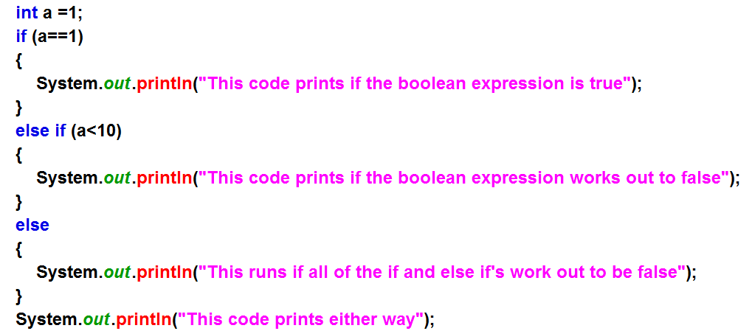
Adding the else
T

Slide 70
If / Else if / Else
F
T

Slide 71
If / Else if / Else
F
F

Slide 72
Week02.Yourturn2.Iffy (PartC)
4 mins

Slide 73
Evaluating multiple boolean expressions
if (myNumber > 10 && myNumber < 20)
If myNumber is
greater than 10
If myNumber is
less than 20
AND
if (myNumber > 10 || myNumber < 20)
If myNumber is
greater than 10
If myNumber is
less than 20
OR
if (myNumber > 10 ^ myNumber < 20)
If myNumber is
greater than 10
If myNumber is
less than 20
XOR

Slide 74
Multiple condition ifs
Week02.multipleconditions.MoreBooleanStuff

Slide 75
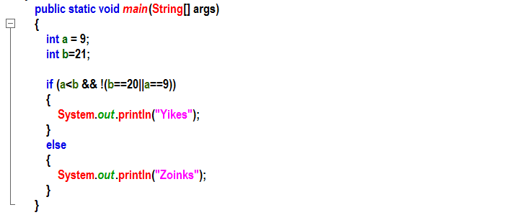
Let’s try a couple
F
F
T
T
T
F

Slide 76
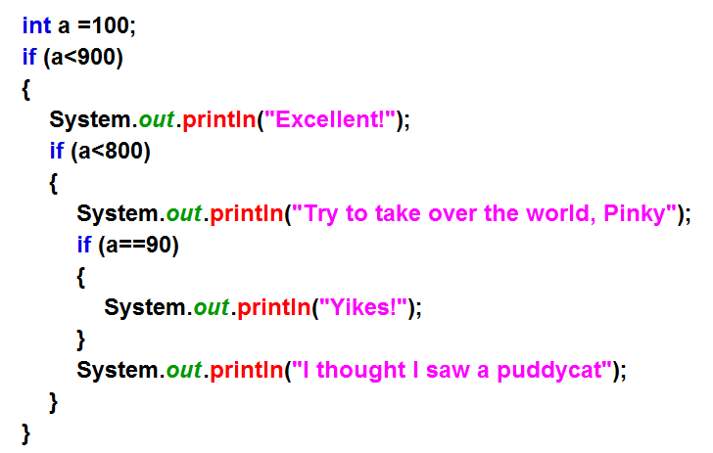
Nested If Statements – Just follow the rules…
T
T
F
Ifs5.java

Slide 77
Scope within if statements
Week02.ifscopes.ScopeInIfs

Slide 78
Interesting Ifs
Week02.interestingifs.Hmmmm.java

Slide 79
Yourturn3:Easy, KindaHard, Hard, Yikes (If you dare!) Also, yourturn4 (let’s do it the easy one together!)
Also, yourturn4
10 mins

Slide 80
Shortcut ifs (ternary operator)

Slide 81
A shorter if/else (ternary operator)
variable = (condition) ? expressionTrue : expressionFalse;
Week-02:shortcutifs:ShortcutIfs

Slide 82
Looping
Why did the programmer spend the entire day in the shower?
Because the shampoo bottle said:
Lather, rinse, repeat!

Slide 83
3 Basic Programming Constructs
Sequence – code runs in order
Selection (Decision) if statements
Iteration
running the same code multiple times
Loops

Slide 84
Why loops are important!
Let’s say that we need to print out 1000 paycheques for our employees
Do you want to write the same code 1000 times with a different name for each??
Loops to the rescue!

Slide 85

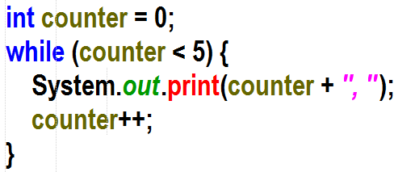
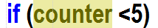
Think about this…
A loop is really just an if statement stuck on a Ferris wheel

Slide 86
Let’s get Loopy!
So far our programs have run from the top to the bottom and then ended.
With loops, we can make our programs run certain parts over and over!
There are three kinds of loop syntax
While loops
Do While loops
For loops

Slide 87
Let’s get loopy!
Week02.loops.Start

Slide 88
While loops
If this condition evaluates to true, the JVM runs the code in this codeblock – just like an if statement!
while (boolean condition)
{
//code that gets executed every time the loop iterates
(need something in here that will eventually make the boolean expression fail)
}
When the JVM gets to the bottom brace bracket, it jumps back up to the while condition and we start all over again…

Slide 89
While loops
If this evaluates to false, the JVM exits the loop by jumping over the codeblock and continuing on with the program…
while (boolean condition)
{
//code that gets executed every time the loop iterates
(need something in here that will eventually make the boolean expression fail)
}
So, really, a while loop is just an if statement that keeps coming back for more until it fails (becomes false)!!!

Slide 90
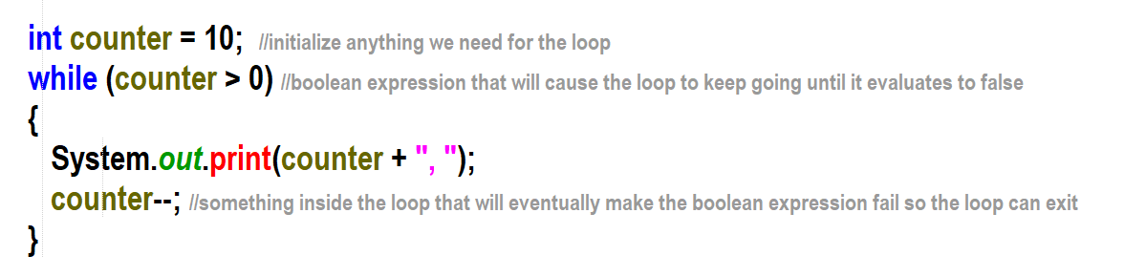
Anatomy of a while loop

Slide 91
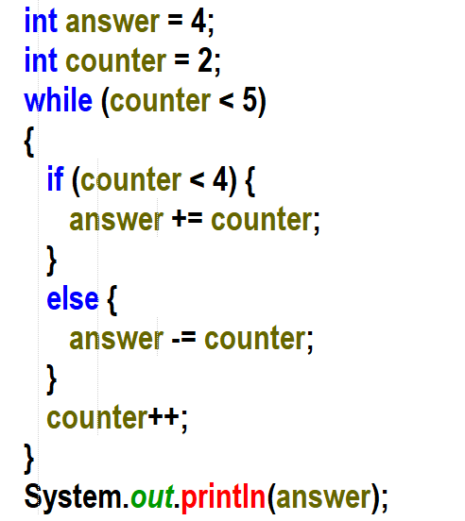
What Prints?
answer | counter | counter <5

Slide 92
What Prints?
answer | counter | counter <5
4 6 9 5 | 2 3 4 5 | T T T F

Slide 93
WhatPrints debug style!
Week02.whatprints.WhatPrints Part A

Slide 94
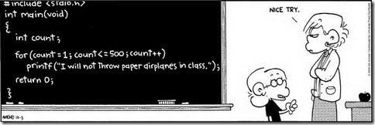
Wouldn’t it have been nice to know loops when you were younger???
class Lines
{
public static void main (String [] args)
{
for (int a = 0; a<1000; a++)
{
System.out.println (“I will not talk in class”);
}
}
}

Slide 95
The Do While (Do Until) Loop – The While loops lazy cousin
A While loop checks for a particular boolean condition at the top, before the loop executes (top checking).
So, if the condition starts out false, it is possible that the while loop will never even run once
When you want to ensure that a loop’s body executes at least one time, you can use a do while loop
In a do while loop, the loop control condition is evaluated at the bottom, after the loop body executes, and the loop continues until the test is FALSE.
Therefore, the body always executes at least one time (bottom-checking)

Slide 96
Do-while loops!
Notice that we don’t check for the condition until the end of the loop
do
{
//statements that execute inside the loop
} while (condition==true);
Like a while loop but we test for leaving the loop at the bottom of our code block instead of the top

Slide 97
for loops
Initial action
Condition for loop to keep looping
for (counter=0; counter<10; counter++)
{
//statements that execute inside the loop
}
The for loop is really just a quicker way to write a while loop that iterates for a certain number of times.
Action after each iteration

Slide 98
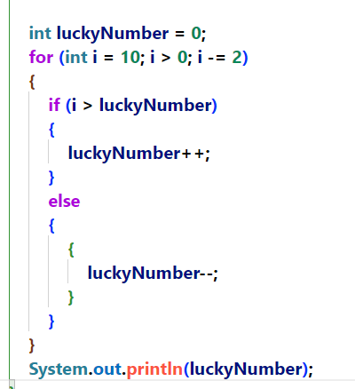
YMWP (Yet more What Prints)

Slide 99
Were we right about what prints?
Week02.whatprints.WhatPrints Part B

Slide 100
Sentinel Loops
Week02.sentinel.Sentinel

Slide 101
Week02.yourturn4.Start

Slide 102
Break, and continue
Week02.breakcontinue.Start

Slide 103
Week02.yourturn5.LogicPractice

Slide 104
Yourturnforsupersmartypants Parts a & b

Slide 105
Yourturnforsupersmartypants Parts a & b

